Slide 1


Nifty – 50 Stock Price Prediction

Slide 2
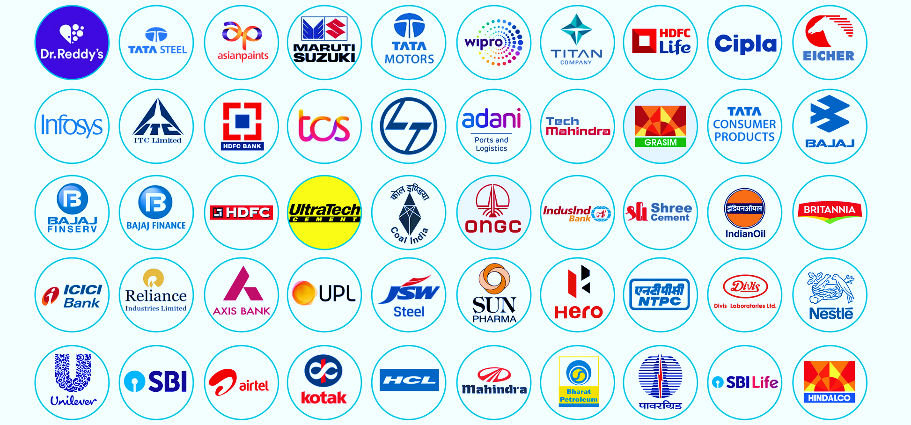
Importance of NIFTY 50 Stocks
Nifty50 is India's benchmark stock market index, representing the performance of the top 50 companies in the country.
It serves as a crucial indicator of the overall health and direction of the Indian economy.
Nifty50 significantly influences investor sentiment, guiding investment decisions and portfolio strategies.
The index reflects market trends, helping investors gauge the overall performance and direction of the stock market.

Slide 3
1. Introduction
2. Meet Our Teammates
3. Objectives
Table of Contents
4. Project Plan
5. Model Building
6. Web Page
7. Model Application
8. Model Limitation
9. Challenges
10. Conclusions

Slide 4




Introduction
As an investment advisor the aim of this project was to predict future prices of Nifty50 stocks using advanced machine learning algorithms.
Here the Investors can use our model to make well-informed decisions based on data-driven insights.
The platform allows users to enter stock details and receive approximate profit/loss estimations.
Our model will empowers investors to optimize their portfolios and enhance trading strategies with reliable forecasts.

Slide 5




Mr. Mayank Rai (Web scraping, Pre-processing, Model Building, Model Testing, Web page designing)
Ms. Kanika Kamra (Model Integration, Model Testing, Google cloud deployment, Presentation)
Meet Our Teammates
Mr. Sachin Kumar Rai (Web scraping, Model Integration, Model testing, Web page designing)
Mr. Dharmendra Kumar (Web scraping, Google cloud deployment, Debugging & Model Testing, Presentation)

Slide 6
The Main Objectives of This Project Are:
Understand the Importance of Nifty50
Describe Data Sources
To Showcase Model Accuracy
To Demonstrate Webpage Interface
To predict profit/loss based on user’s:
Stock name
Quantity
Buying date
Selling date
Emphasize Real-world Applications
Future Plans
Objectives

Slide 7
Web Scrapping
Final Presentation
Pre-processing
By following this comprehensive project plan, our team of 4 members has effectively created a robust Nifty50 Stocks Price Prediction system with enhanced accuracy and user satisfaction.
Team Collaboration
Model Selection
Project Plan
Google Sheet Integration
Model Training
Web Page and UI
Testing and Validation

Slide 8
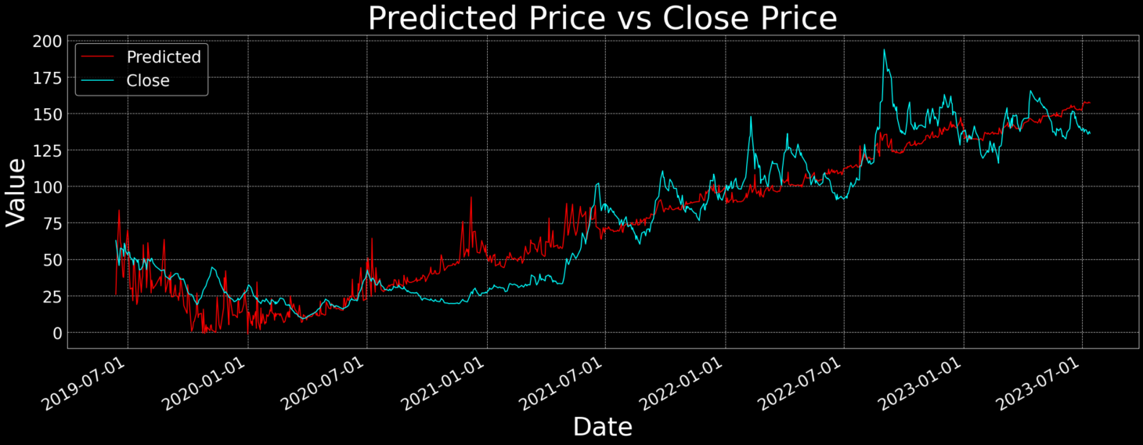
Model Building
Our machine learning model utilizes polynomial regression to predict profit/loss in Nifty50 stocks.
Accurate predictions assist investors in making informed decisions.
The model is trained on historical stock data to ensure reliability.
It offers a user-friendly interface for inputting stock details and obtaining predictions.
This project showcases the application of AI in real-world financial analysis.

Slide 9
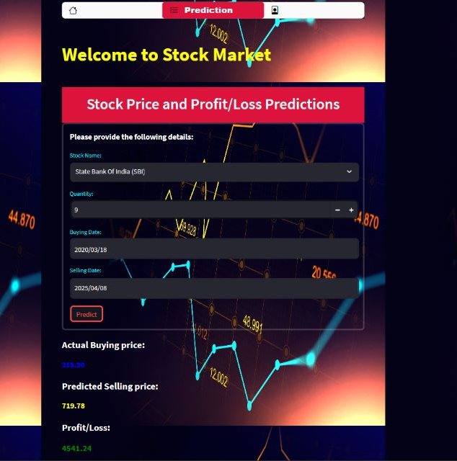
Web Page
The web page allows users to input stock details, quantity, buying, and selling dates for personalized predictions.
User-friendly interface for inputting stock details, quantity, buying, and selling dates.
Accurate predictions aid investors in making informed decisions.
Validation through training on historical stock data ensures reliability.
Practical application of AI in financial analysis, optimizing investments.

Slide 10
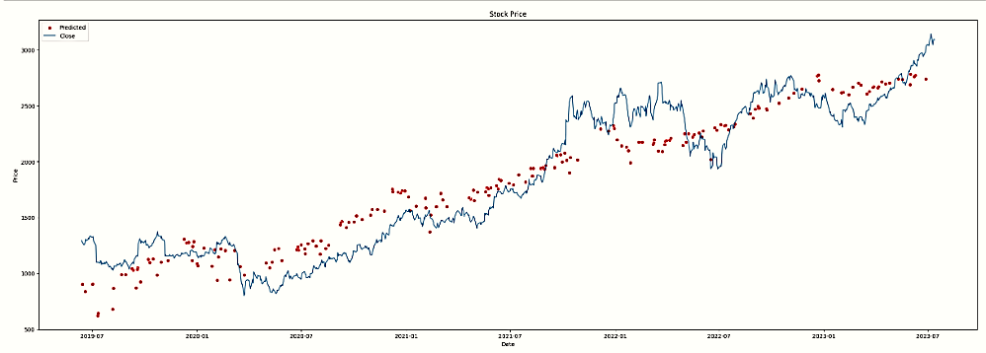
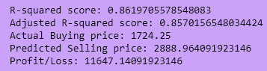
Model Evaluation
Applied various algorithms (ARIMA, XGBoost, GARCH) on stock market data, but achieved superior accuracy with polynomial regression.
Therefore we finalized with polynomial regression model and evaluated it using R2 score and adjusted R2 score.
R2 score measures the proportion of variance explained by the model,
while adjusted R2 accounts for the number of features used, providing a more robust accuracy assessment.
Stock_Name | Titan Company Ltd (TITN)
Total quantity | 10
Buying_Date | 2021-07-13
Selling_Date | 2023-07-25
Final_P&L | 11647.14092

Slide 11
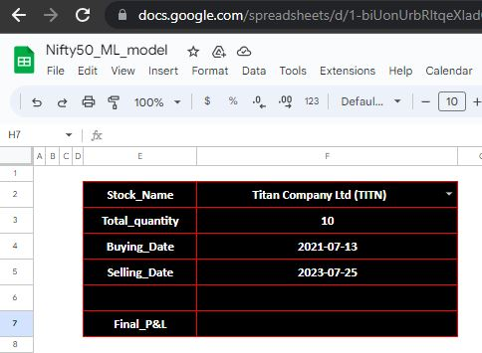
Model Application
Informed Investment Decisions
Risk Management
Portfolio Optimization
Financial Planning
Enhancing Market Understanding
Empowering Individual Investors
Confidence in Decision-making
Validating Existing Strategies
Future Applications
Our model will leverages the power of data and machine learning to empower investors and traders with valuable insights, fostering data-driven decision-making and enhancing overall performance in the financial sector.

Slide 12
Model Limitation
Limited data:
Utilizing only 4 years of historical data might not capture long-term trends and patterns that could significantly influence stock prices.
Overfitting risk:
Polynomial regression may lead to overfitting due to its sensitivity and small fluctuations in the data.
Limited input features:
Relying solely on close price, volume, and date might not encompass all relevant factors impacting stock performance.
Market complexity:
The stock market is influenced by multifaceted factors, including geopolitical events and macroeconomic trends, which may not be accounted for in the model.

Slide 13

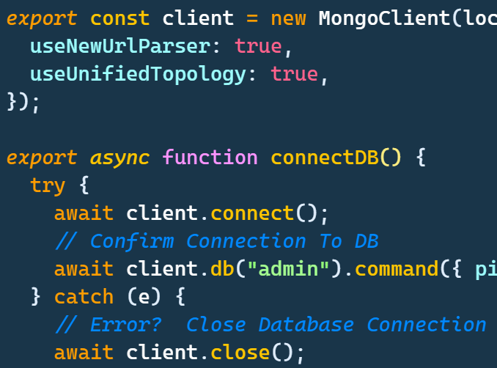

Integrating the machine learning model with Google Cloud and Google Sheets posed initial challenges.
Deploying the model on the web page required optimizing performance and ensuring functioning of the web page.
Challenges
Coordinating frontend and backend development for seamless user experience was a complex task.
Overcoming hurdles in data handling and processing to deliver accurate predictions to users.

Slide 14
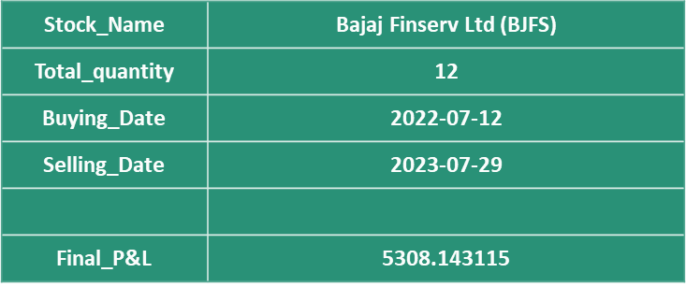

Conclusion
Our team successfully developed a Google sheet and also web-based machine learning model utilizing polynomial regression to predict profit/loss in Nifty50 stocks.
Users can input stock details, quantity, buying, and selling dates to get predictions for his/her portfolio either he/she will be in profit/loss.
This project demonstrates our collaborative efforts in applying AI for real-world financial analysis and decision-making.

Slide 15

Team Members:
Ms. Kanika Kamra
Mr. Mayank Rai
Mr. Sachin Kumar Rai
Mr. Dharmendra Kumar
Batch: PTDA-20

